Slide 1
Chapter 1: Operating System Theory
A Guide to Operating Systems: Troubleshooting and Problem Solving

Slide 2
Chapter Objectives
Understand what an operating system does
Describe the types of operating systems
Understand the history of operating system development
Discuss single-tasking versus multitasking
Differentiate between single-user and multi-user operating systems
List and briefly describe current operating systems

Slide 3
Understanding Operating Systems
Operating System (OS) - a set of basic programming instructions to computer hardware, forming a layer of programming code on which most functions of the computer are built
The OS takes care of basic input/output (I/O)
The OS communicates with all devices (floppy drive and CD-ROM) using device drivers

Slide 4
An Operating System’s Tasks
Handle input from the keyboard
Handle output to the screen and printer
Control input/output with all bus devices, such as a network interface card
Control information storage and retrieval using various types of disk drives

Slide 5
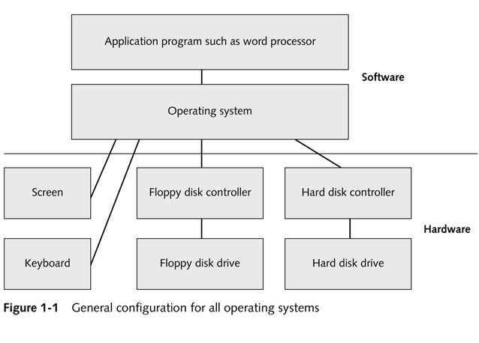
General Configuration for All Operating Systems

Slide 6
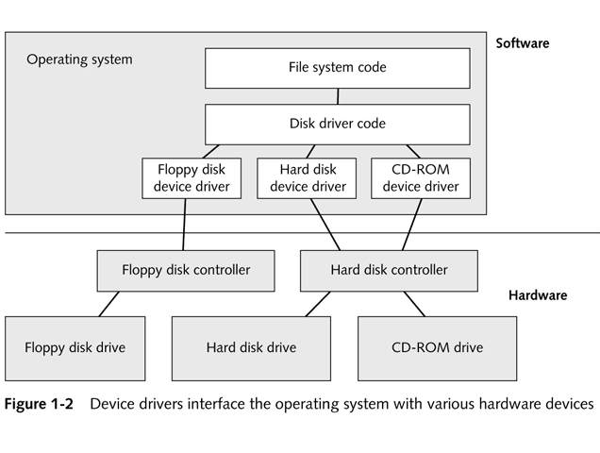
Device Drivers interface the Operating System with various hardware devices

Slide 7
Devices Requiring Drivers
Scanners
Printers
CD-ROM
Specialty devices such as digital cameras
Other video input devices
Audio transfer hardware

Slide 8
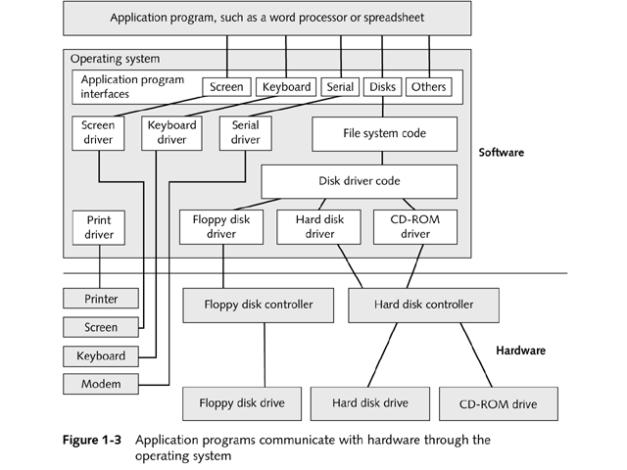
Applications Communicate with Hardware

Slide 9
Operating System Structure
Basic Input/Output System or BIOS
Read Only Memory or ROM
Central Processing Unit (CPU)

Slide 10
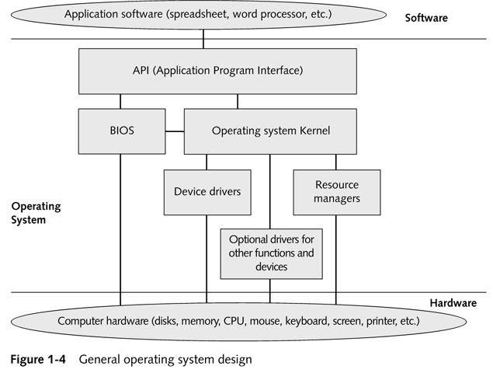
General Operating System Design

Slide 11
Elements of Operating System Design
Application Software (spreadsheet and word processor)
API (Application Program Interface) communicates with the application and the user
BIOS provides basic input/output functions to communicate with system devices
Operating System Kernel coordinates operating system functions such as memory and storage
Kernel communicates with BIOS, device drivers, and API

Slide 12
Elements of Operating System Design
Device drivers - programs that take requests from the API via the kernel and translate them into commands
Resource managers - manage computer memory and central processor use
Optional drivers are used for special functions and devices
Computer hardware - disk, CPU, mouse and keyboard drivers

Slide 13
Features of Most Modern Operating Systems
Provide an interface between the computer hardware and application programs
Act as an intermediary between the user and applications
Provide a user interface into computer hardware and application programs
Manage memory and central processor use
Manage peripheral devices such as printers, monitors, keyboards, and modems

Slide 14
Common types of Operating Systems
UNIX
Windows NT
Macintosh OS

Slide 15
How Operating Systems Are Organized
Size
Type
Purpose of computer
  Personal computers
  Corporate computing (confined to mainframe and microcomputer-class devices)

Slide 16
Multi-User Operating Systems
Include multiple CPU’s
Have stronger than usual I/O capabilities
Examples:
  UNIX
  Windows NT

Slide 17
Large Computer Systems
Mainframe-class computers are used to conduct massive calculations and manipulate huge amounts of data
Mainframe-class computers are known as time-sharing systems
Large computers conduct batch processes
Smaller systems use sequential processing

Slide 18
Medium Computer Systems
Medium sized computers use real time systems
Several users using one machine or a group of a few machines is known as a multi-user environment
Newest type of large computing system environment is client/ server system

Slide 19
Evolution of Operating Systems
Read punch cards or tape
Performed precise tasks
Input and Output devices
Mid 1970’s included a display terminal (a teletype machine and keyboard)

Slide 20
Early Operating Systems
PDP-Series Computers ran the DEC operating system (known as OS)
Popular version was OS/8
Release 3Q (1968)

Slide 21
Programming Languages
BASIC - Beginner’s All-Purpose Symbolic Instruction Code
Pascal
C
FORTRAN
COBOL

Slide 22
DOS AND PC-DOS
Disk Operating System (DOS) loaded from disk or tape
Designed for microcomputers
Renamed MS-DOS (Microsoft)
IBM bought a license for MS-DOS and dubbed it PC DOS

Slide 23
IBM’s First PC
Introduced in 1981
Designed around an open standard
Anyone was welcome to make PCs that worked like IBM PCs or hardware that would work with the IBM PC

Slide 24
What Does DOS Do?
Supports basic functions such as keyboard, disk, and printer I/O
Controls communications with the outside world
Allows more support functions to be added such as hard disks and graphical interfaces

Slide 25
Mac OS versus Windows
Macintosh OS manages memory for software
Mac OS allows you to start several programs sequentially and switch among them
DOS provides a graphical interface called Microsoft Windows with many of the same functions as Mac OS

Slide 26
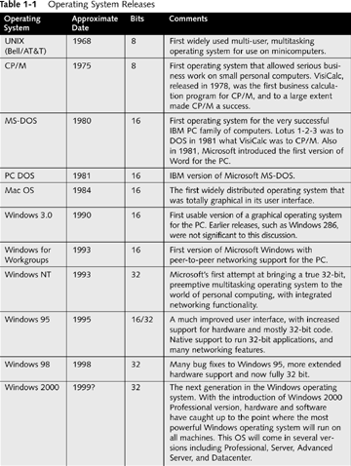
Operating System Releases

Slide 27
Single-Tasking versus Multitasking
Multitasking - a technique that allows a computer to run two or more programs at the same time
Cooperative multitasking - hands over control to a program and waits for program to hand control back to the operating system
Preemptive multitasking - the operating system is in control of the computer at all times
Task-switching - can actively execute one application at a time

Slide 28
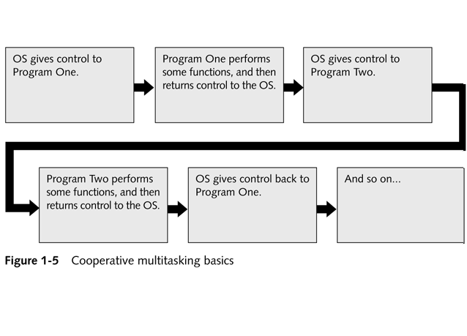
Cooperative Multitasking Basics

Slide 29
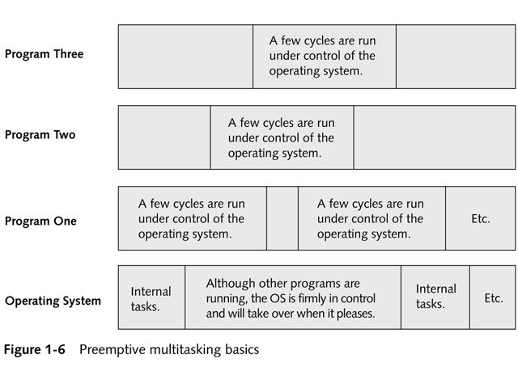
Preemptive Multitasking Basics

Slide 30
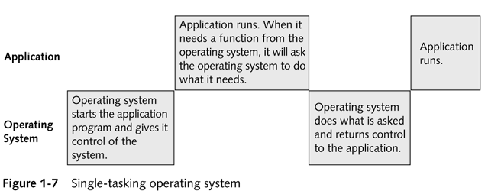
Single-Tasking Operating System

Slide 31
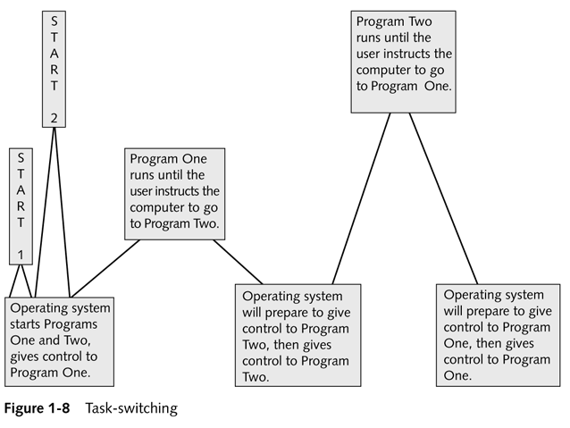
Task-Switching

Slide 32
Single-User versus Multi-User Operating Systems
Single-user operating systems - allow only one user to use an application
Multi-user operating systems - allow multiple users to use an application at the same time
Most multi-user systems use preemptive multitasking
With the exception of UNIX, all operating systems covered in this book were designed as single-user systems

Slide 33
Current Operating Systems
MS-DOS
PC DOS
Windows 95/98
Windows NT
UNIX

Slide 34
Chapter Summary
Chapter One:
  Provides an overview of how operating systems work
  Discusses the Input/Output functions provided by the BIOS
  Introduces device drivers and the functions an operating system provides to an application

Slide 35
Chapter Summary
  Gives a brief history of operating systems and describes the different operating systems in use
  Explains the differences between single-user and multi-user operating systems

